Slide 1

FINAL STATISTICAL COMPUTING PROJECT

Slide 2

DATA ANALYSIS
Presented by:Bhawesh joshi

Slide 3





INDEX
INTRODUCTION
DATASET DEFINITION
R DATASET , CODE,
DEFINITIONS & OUTCOMES
NEW R FUNCTIONS & ITS UTILITY
SUMMARY

Slide 4
INTRODUCTION
Spotify is a digital music, podcast, and video service that gives you access to millions of songs and other content from creators all over the world.
This project will deal with 50 songs(Observations )having different Track names and artist's name. There are other also variables like Beats per minute, Energy, danceability, Loudness, Liveness, Valence, Length, Acousticness, Speechiness, Popularity. We here to analyze what variable affects the Popularity the most based on the other variables.
Programming Language R has been used for the Project Analysis

Slide 5
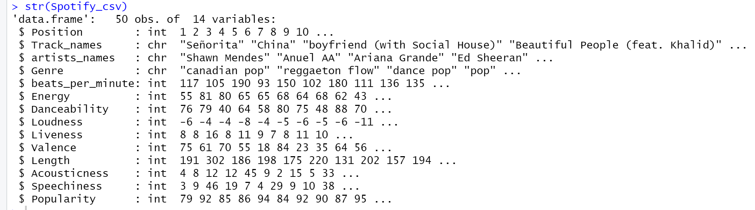

DATASET DEFINITION
DATASET

Slide 6
Scaling
The data has been further standardized so that it does not impact our eda.
Function used– Scale()

Slide 7
Source of DATASET
Source of the Dataset
https://www.kaggle.com/search?q=Top+50+Spotify+Songs+-+2019

Slide 8
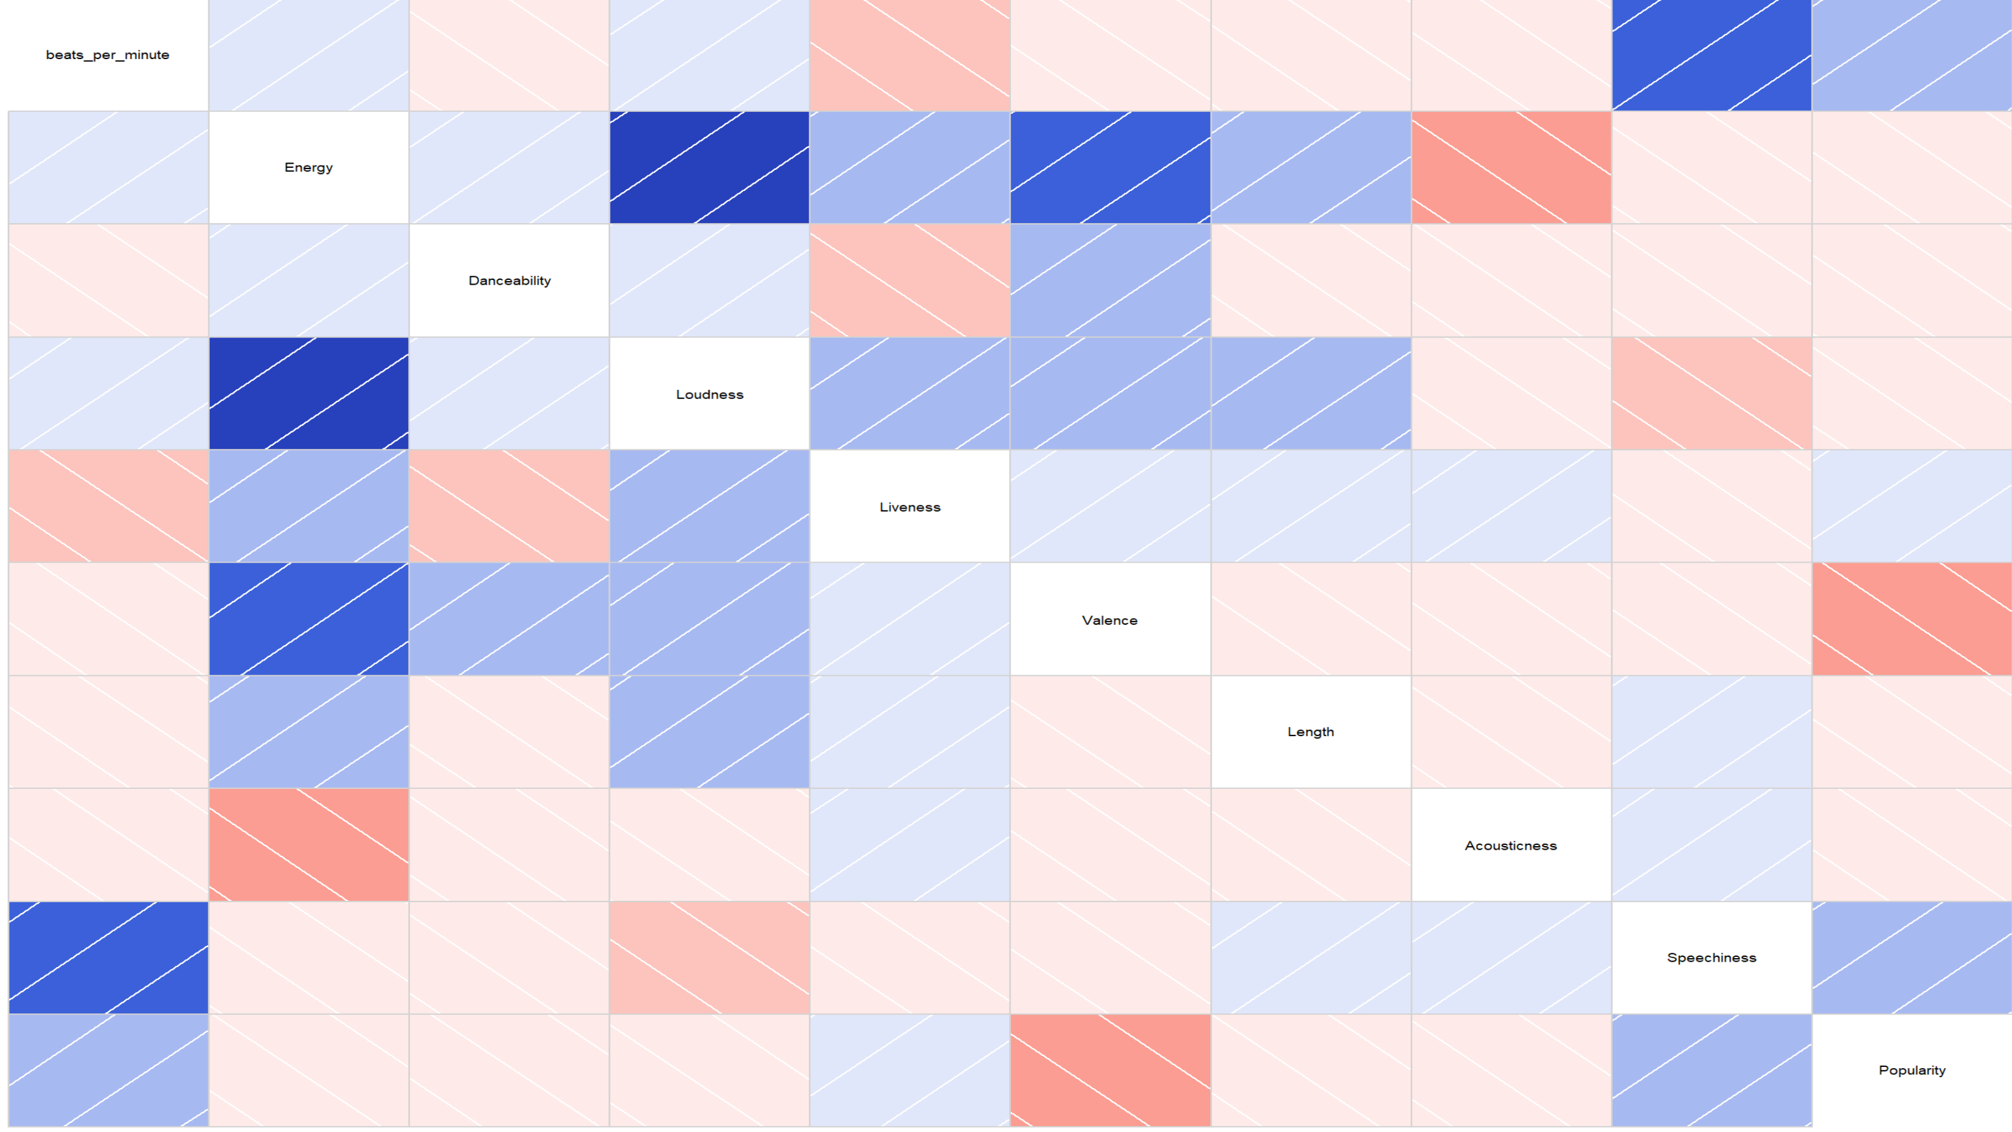
Corrgram GRAPH
Library Used – corrgram
Plot Detail – Beats per minute, Energy, danceability, Loudness, Liveness, Valence, Length, Acousticness, Speechiness, Popularity
Observation – On comparing with Populariry we see through the graph that Speechiness and popularity provides us with most correlation.
Conclusion – By graph we cannot colclude,but it does provide us a way in which direction to look into,i.e-Speechiness & Beats per min.

Slide 9
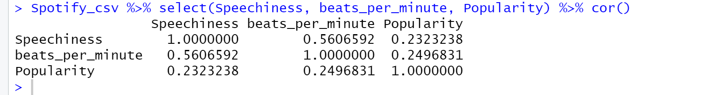
Correlation -extended
Library Used – tidyverse, corrgram
Plot Detail – The plot shows the
correlation between Speechiness, Beats per min and popularity of a song.
Observation – Backed up by the visual graph on the previous slide, Speechiness and beats per min are most correlated with popularity of a song.

Slide 10
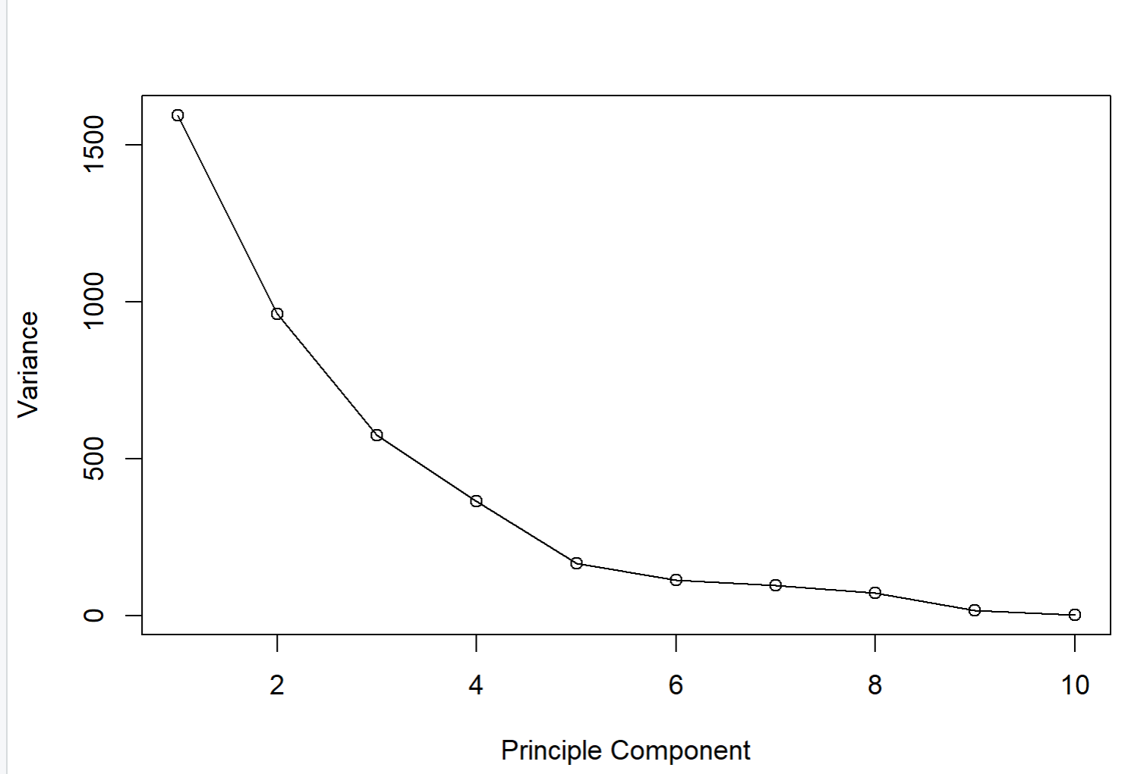
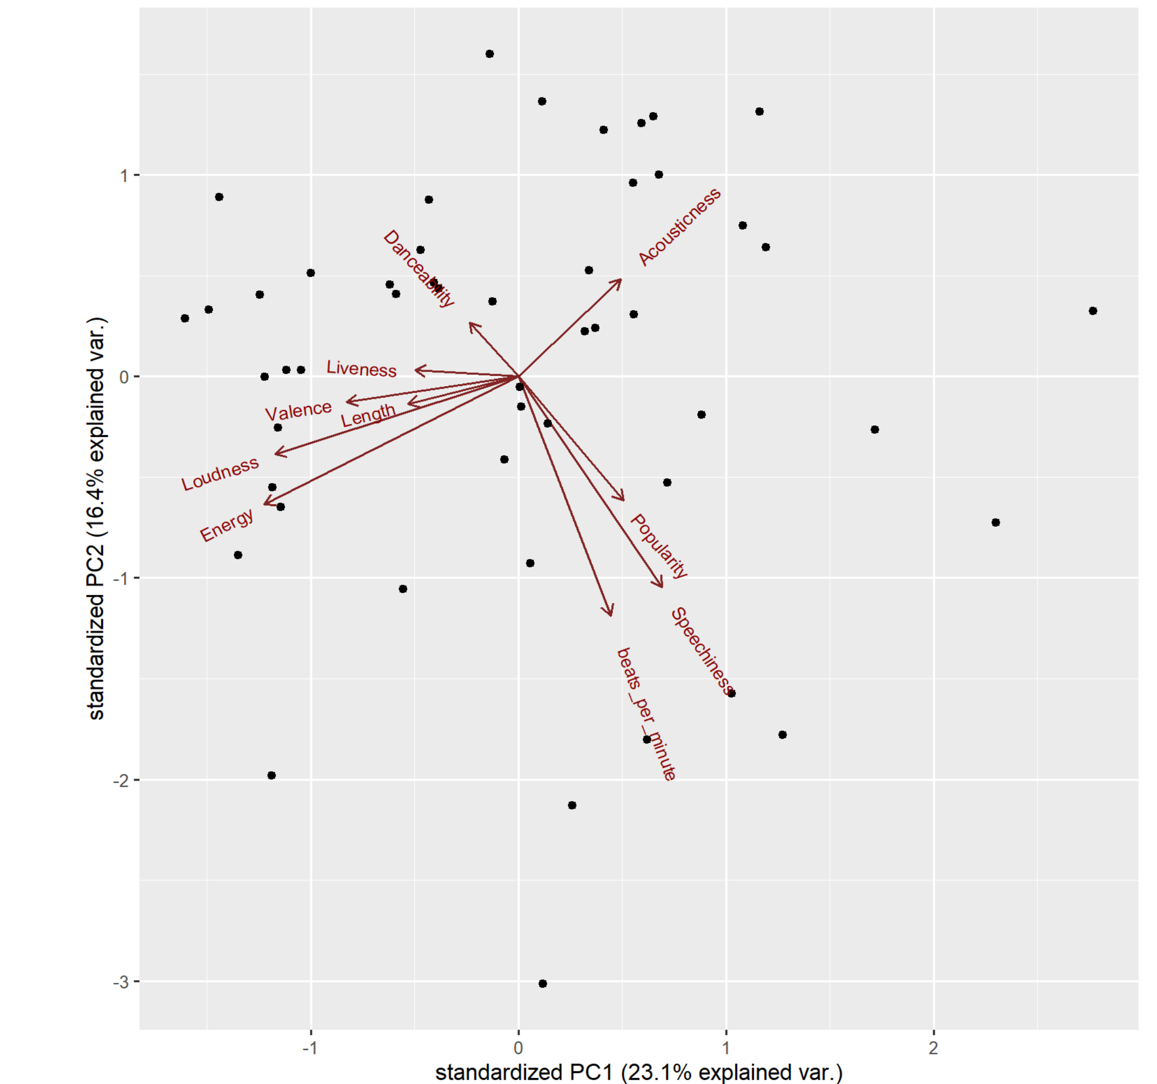
PCA Analysis
Library Used – ggbiplot
Why PCA– SINCE THERE ARE MANY VARIABLES, the idea of PCA is Used— reduce the number of variables of a data set, while preserving as much information as possible.
Observation – The relationship between variance and information here, is that, the larger the variance carried by a line, the larger the dispersion of the data points along it, and the larger the dispersion along a line, the more the information it has.We again found Poularity,sppechiness are most correlated.

Slide 11
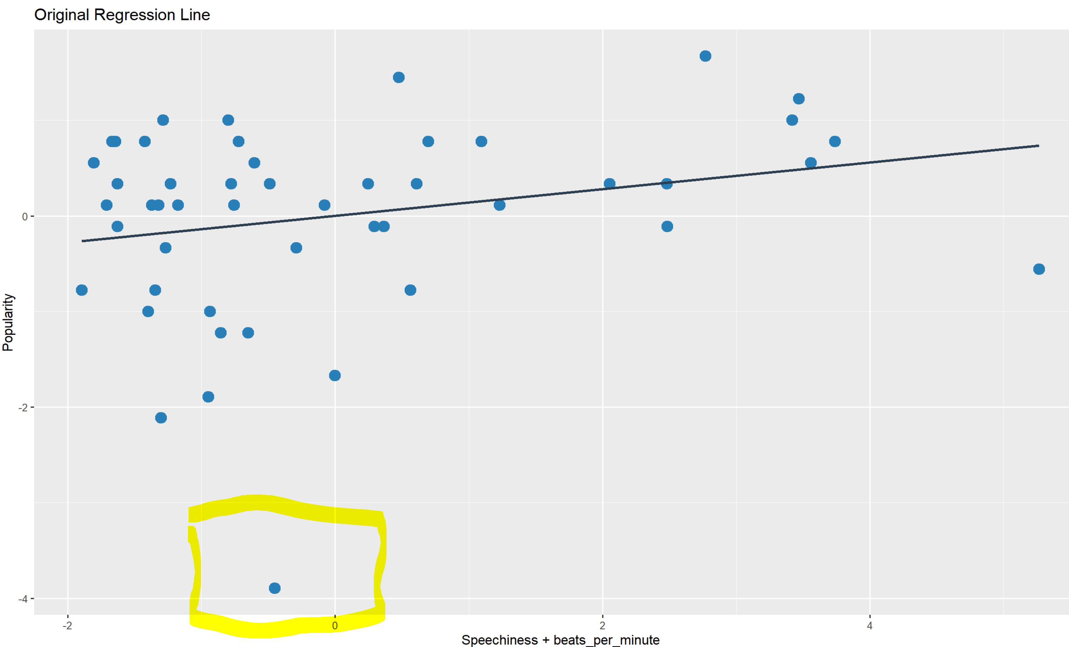
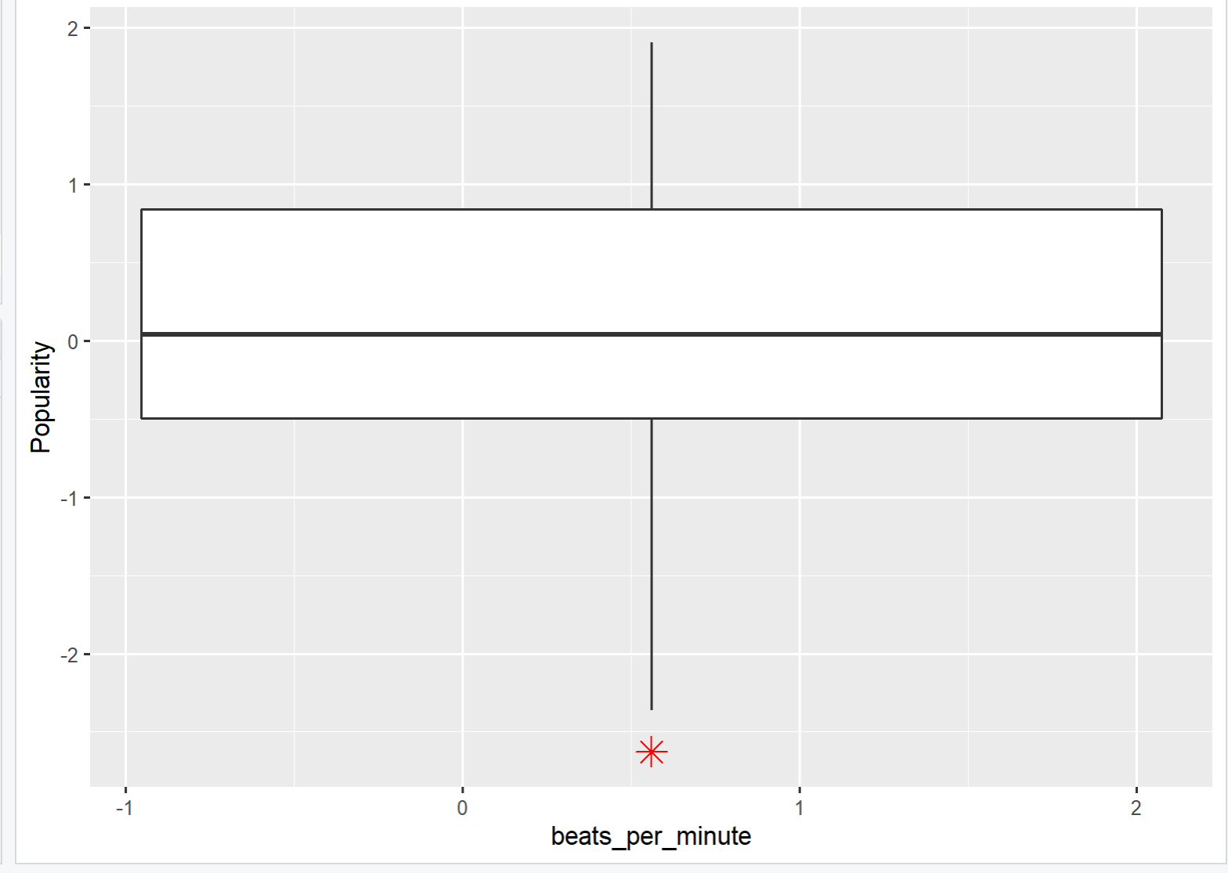
Regression LINE
Library Used – gridExtra, ggplot
Plot Detail– a LINEAR MODEL WITH Popularity as Y axis and Speechiness & beats per min as x axis.
Observation – We observe an outlier which may dissuade our result in our end.as I observed later, the outlier did create an issue in our model and hence it was wise to remove the outlier data.

Slide 12
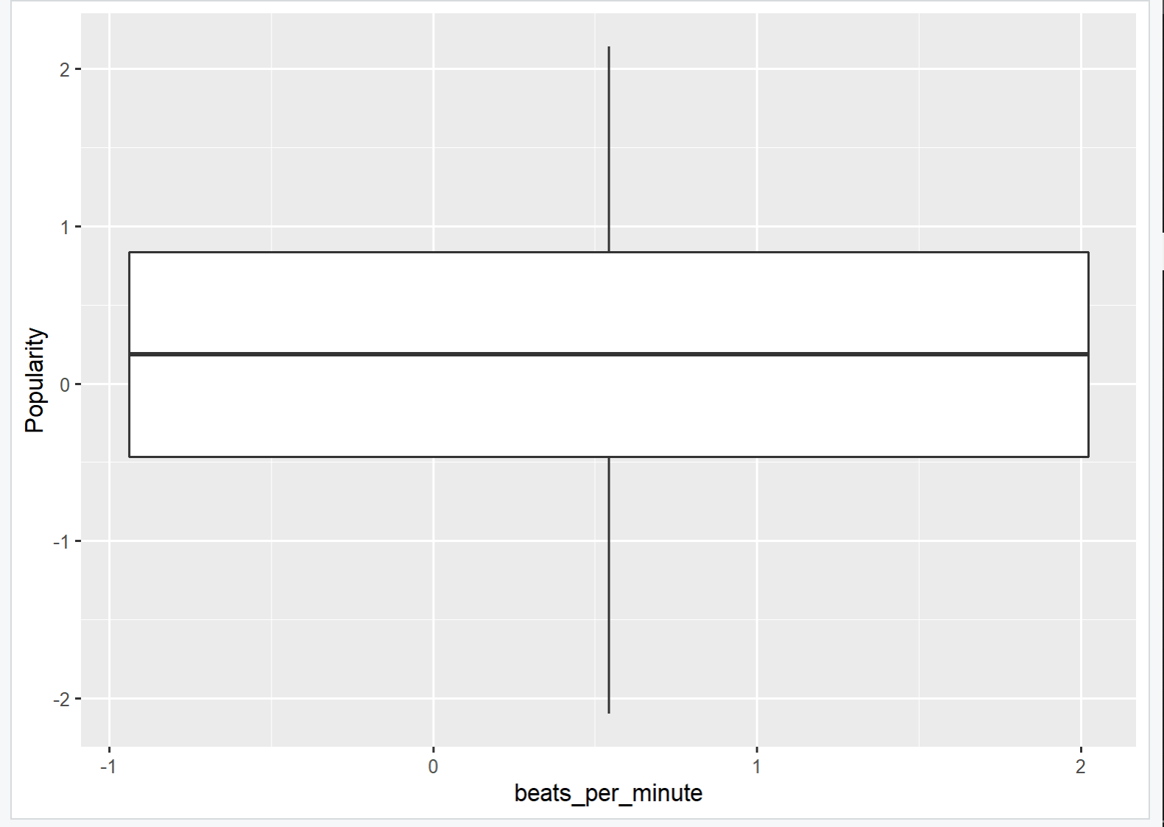
Regression LINE
On removing 3 POP songs including Senorita, i'm lonely (with Anne-Marie) - from “13 Reasons Why: Season 3”,sucker From Jonas brothers,WE REMOVE THE OUTLIERS FROM OUR DATA

Slide 13


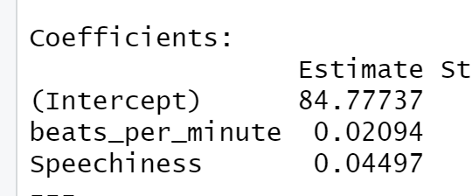
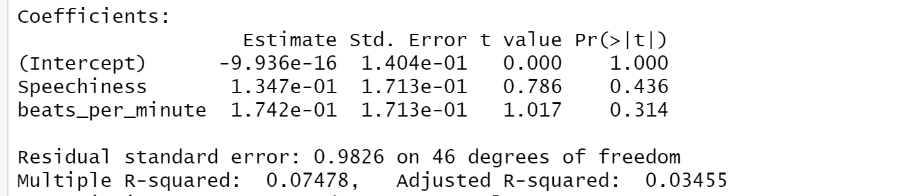
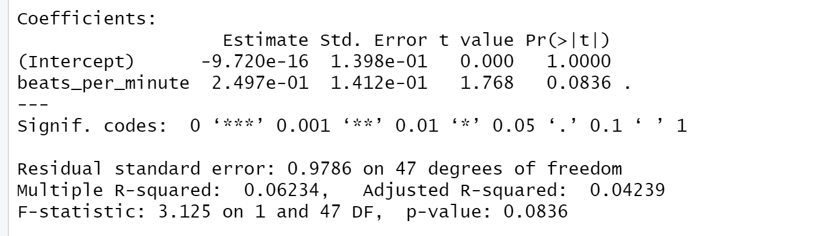
Regression Model
REGRESSION Summary Model–
Through an intercept we observe that for a value increase in Beats per minute IN SPEECHINESS there is an increase of POPULARITY level OF 0.03002 & 0.04497 respectively.
THE CLOSER THE T-VALUE IS TO ZERO,THE LESSER THE CHANCES OF REJECTING THE NULL HYPothesis,and thus we can still assume there is a relationship between Speechiness , beats per minute with popularity.
In our example, the R Square we get is 0.03845. Or roughly 3.85% of the variance found in the response variable (popularity) can be explained by the predictor variable (beats per minute).
We must remove SPEECHINESS BECAUSE IT HAS HIGH P value,And once we DO THAT ,WE SEE THAT
THE ADJUSTED r SQUARE VALUE HAS IMPROVED.

Slide 14
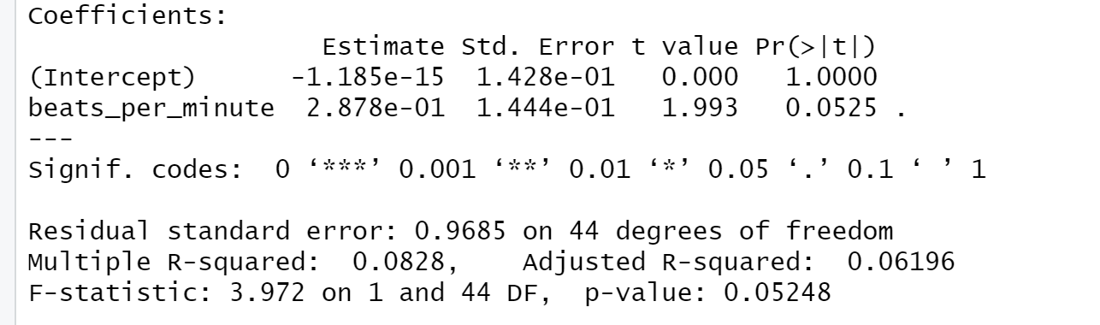
Regression Model -CONT
We must remove SPEECHINESS BECAUSE IT HAS HIGH P value,And once we DO THAT ,WE SEE THAT
THE ADJUSTED r SQUARE VALUE HAS IMPROVED.
The P value has ALSO IMPROVED ON REMOVAL OF THE OUTLIERS

Slide 15
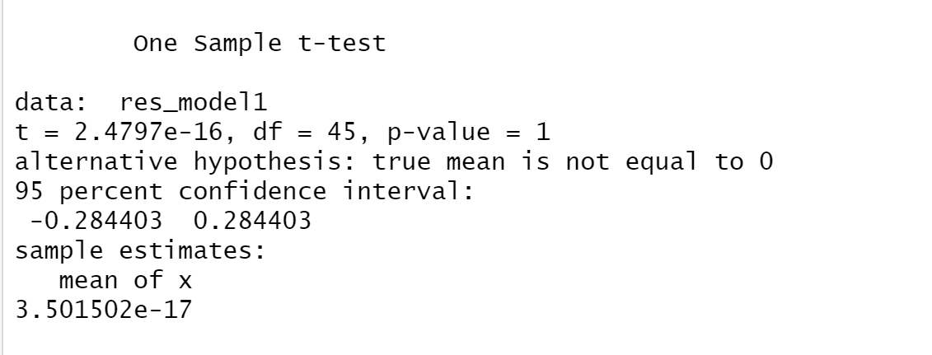
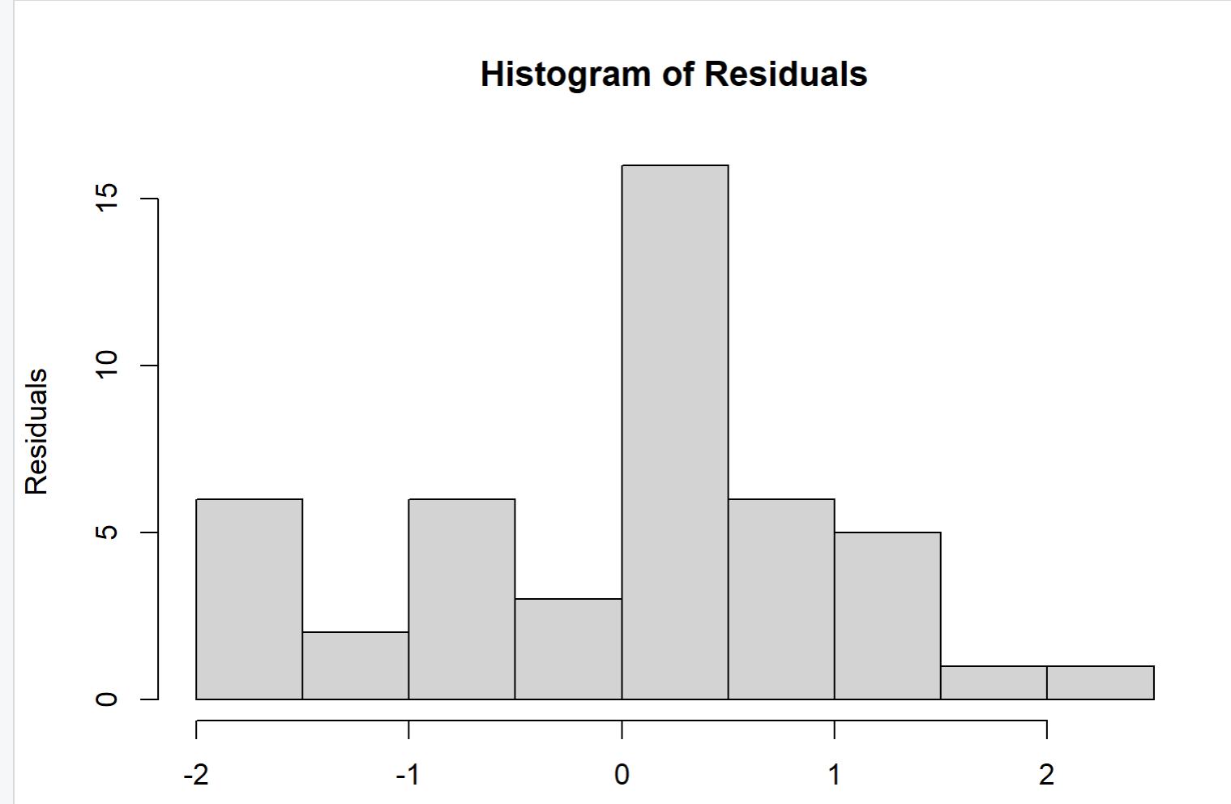
ANALYZING RESIDUALS
since p value is 1 ,true mean is equal to zero
the histogram looks like a bell-curve it might be normally distributed.

Slide 16
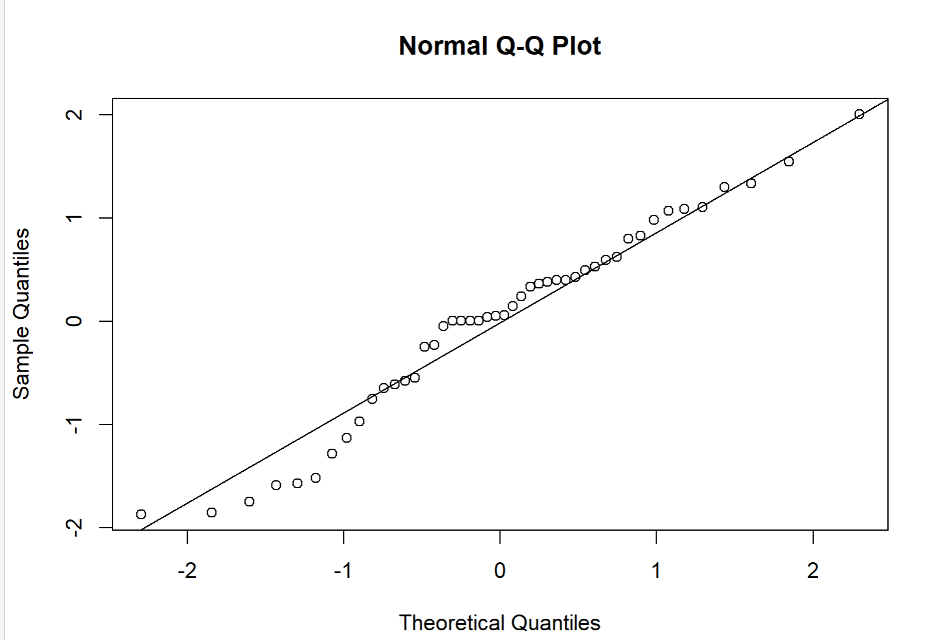
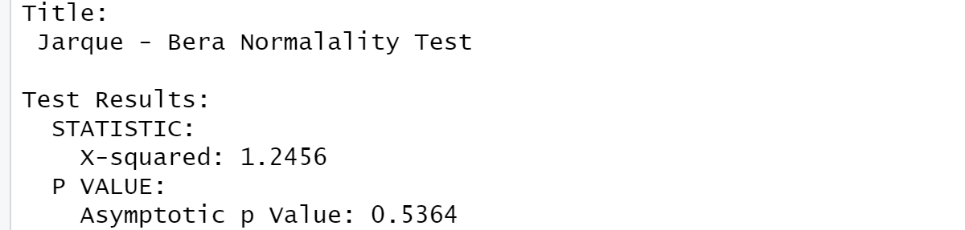
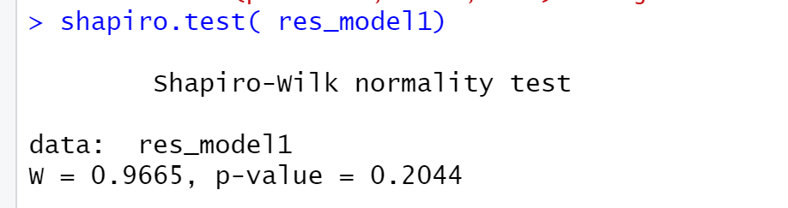
ANALYZING RESIDUALS-Cont
Q-Q Plot
The null hypothesis of the Jarque-Bera test is a joint hypothesis of the skewness being zero and the excess kurtosis being zero. With a p-value >0.05, one would usually say that the data are consistent with having skewness and excess kurtosis zero.
Conclusion-Residuals are normally distributed.

Slide 17
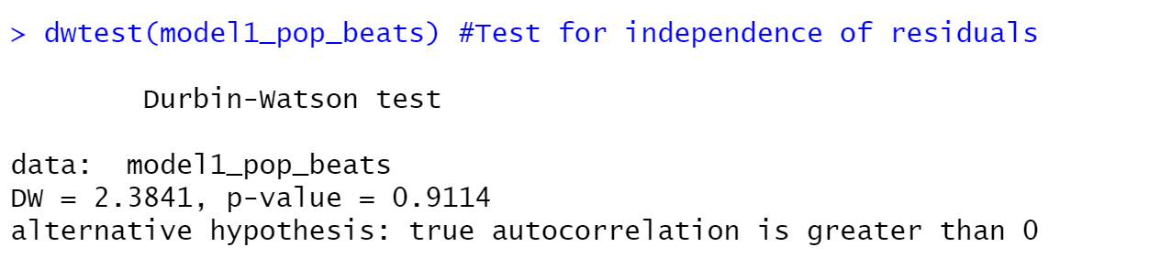
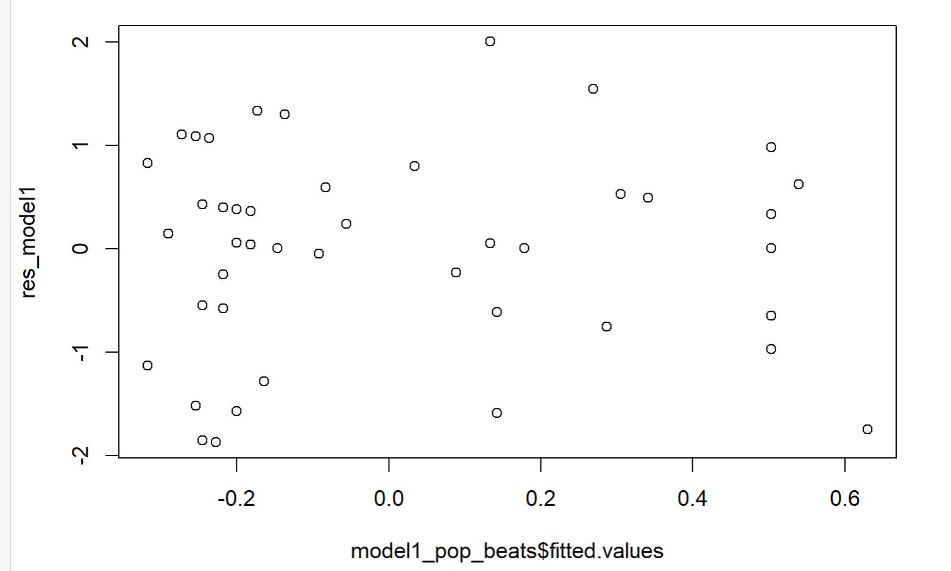
ANALYZING RESIDUALS-Cont
DWTEST(Test for independence of residuals)
By the alternative hypothesis we can derive that correlation between neighboring values
since the residuals for the model donot follow any pattern,The errors are distributed with a constant variance Conclusion-Residuals are normall distributed.

Slide 18
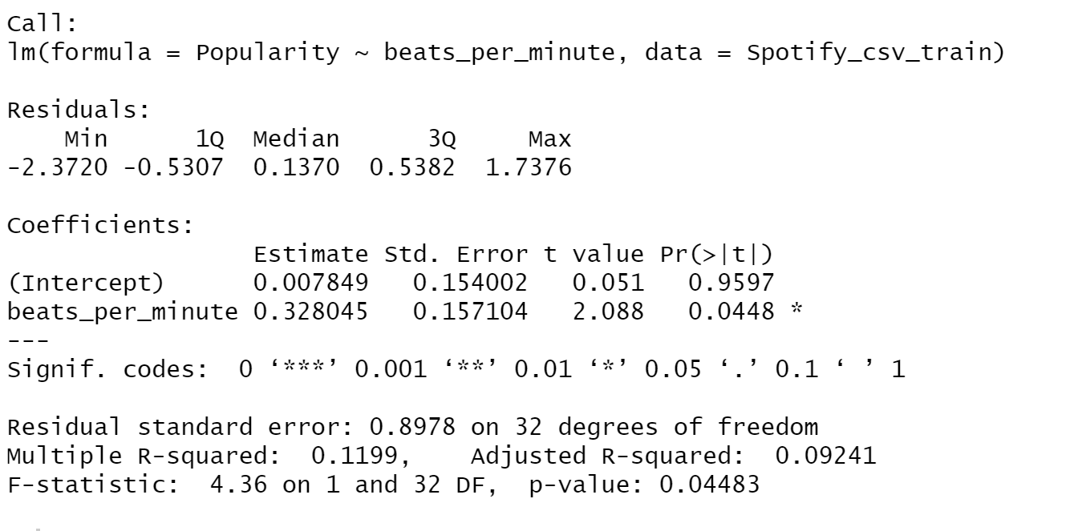
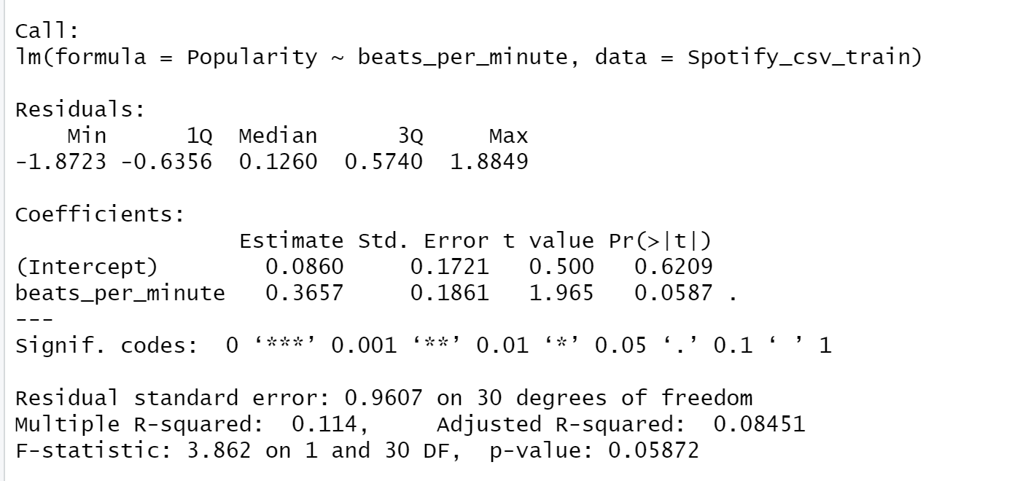
model performance measures

Slide 19
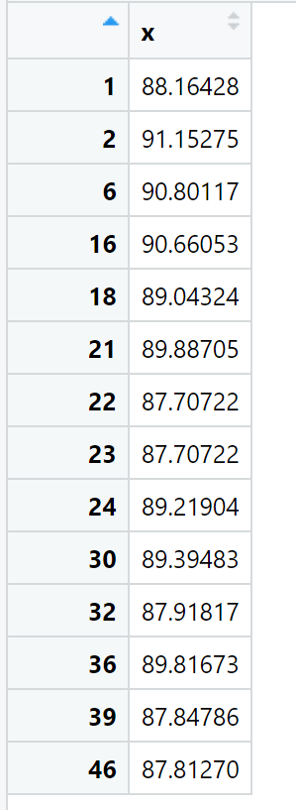
Prediction model
WE can now predict through our test data that the listed beats per minute are required for the popularity.

Slide 20
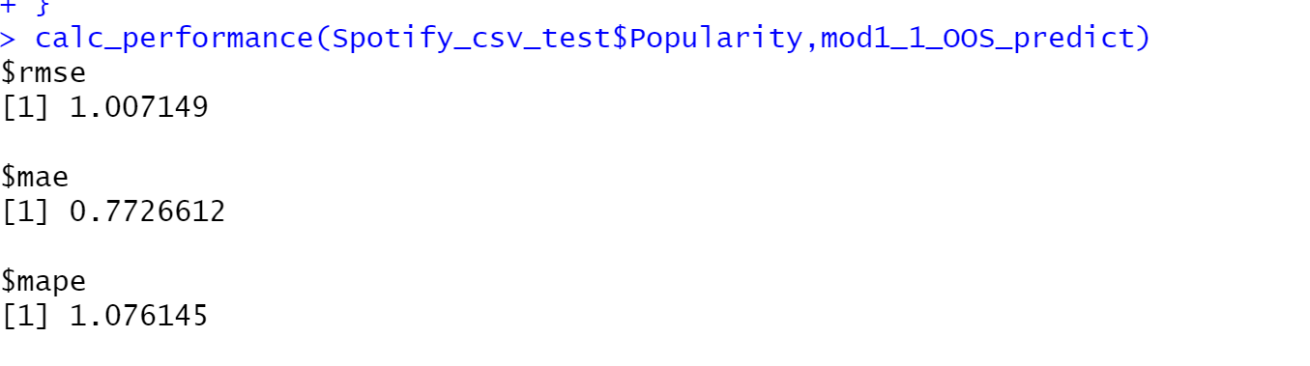
METRICS TO TEST ACCURACY
We test the accuracy of our model through RMSE,MAE,MAPE and conclude that there is not significant difference between our actual and predicted model.

Slide 21
NEW R FUNCTIONS USED :
R FUNCTION | WHAT IS THE MEANING ? | WHY HAS IT BEEN USED ?
corrplot | It provides a visual exploratory tool on correlation matrix that supports automatic variable reordering to help detect hidden patterns among variables. | To draw the correlation matrix and correlogram
prcomp | Performs a principal components analysis on the given data matrix and returns the results as an object of class prcomp. | Helped in figuring the most correlated values.
qqnorm | qqnorm is a generic function the default method of which produces a normal QQ plot of the values in y.qqline adds a line to a “theoretical”, by default normal, quantile-quantile plot which passes through the probs quantiles, by default the first and third quartiles. | To test the residuals.
lm | lm is used to fit linear models. It can be used to carry out regression, single stratum analysis of variance and analysis of covariance (although aov may provide a more convenient interface for these). | Used in line chart and pie chart to make the graph interactive .
ggally | It is an extension of the ggplot2 package and adds several additional functions for the plotting of data in R. | To plot the scatter plot matrices
cor.test | Test for association between paired samples, using one of Pearson's product moment correlation coefficient, Kendall's tau or Spearman's rho. | To test between the beats per minute and popularity

Slide 22

Code

Slide 23
SUMMARY
R as a language is very useful for predictive analysis and for data analysis
Using Spotify dataset, it was very evident that beats per per minute is one of the important criteria for the popularity of a song.
From the above analysis,the Artists should keep an average of 85 beats per minute to increase the popularity of a song.
Visual Data does not always represent the true picture and hence it is equally important to test the data model through various functions.

